Slide 1
LENDING CLUB CASE STUDY PART OF THE MACHINE LEARNING AND NLP PROGRAMME BY IIIT BANGALORE / UPGRAD
SUBMISSION by: aadil sheikh and SIDDHARTHA GHOSH
NOVEMBER 14, 2022

Slide 2
STRUCTURE OF THIS DOCUMENT
PROBLEM STATEMENT
PROCESSES / STEPS
SUMMING UP AND NEXT STEPS

Slide 3
THE PROBLEM STATEMENT
From records available with / provided by The Lending Club, to identify the key drivers of Loan Defaults.

Slide 4
PROCESSES / STEPS
Data Examination
Data Cleansing
Exploratory Data Analysis
Initial Observations and Inferences
Next Level Analysis

Slide 5
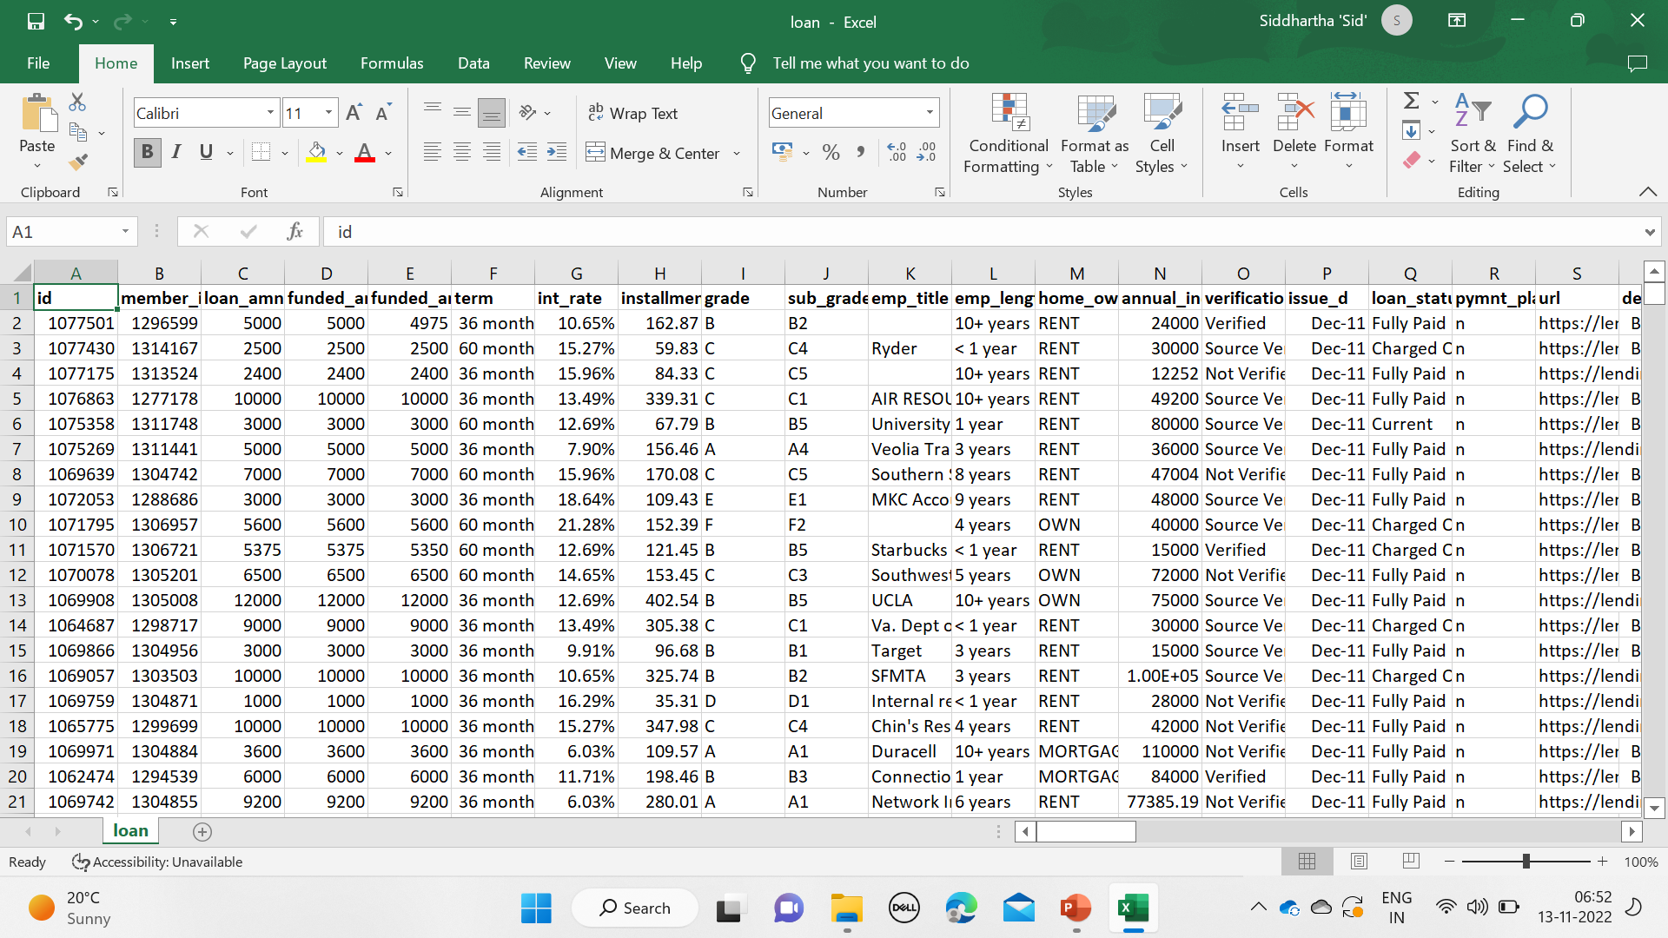
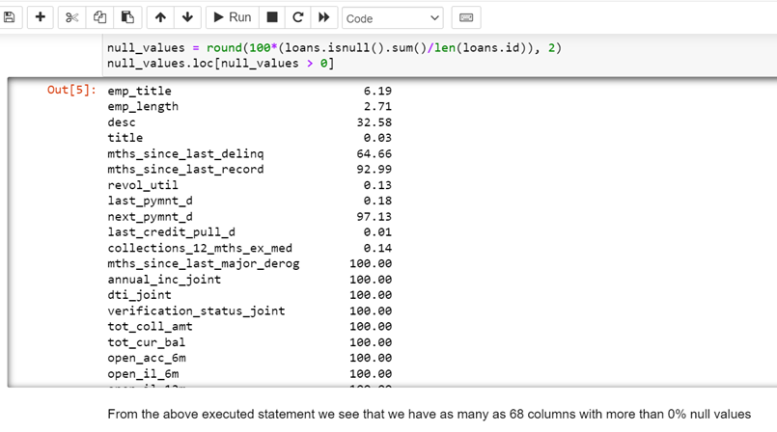
Step B: Data examination
At first sight of the Excel Sheet, we noticed a mix of Categorical, String as well as Continuous Data.
There were also as many as 68 columns containing Null values, though to various degrees from .01% to 100%

Slide 6
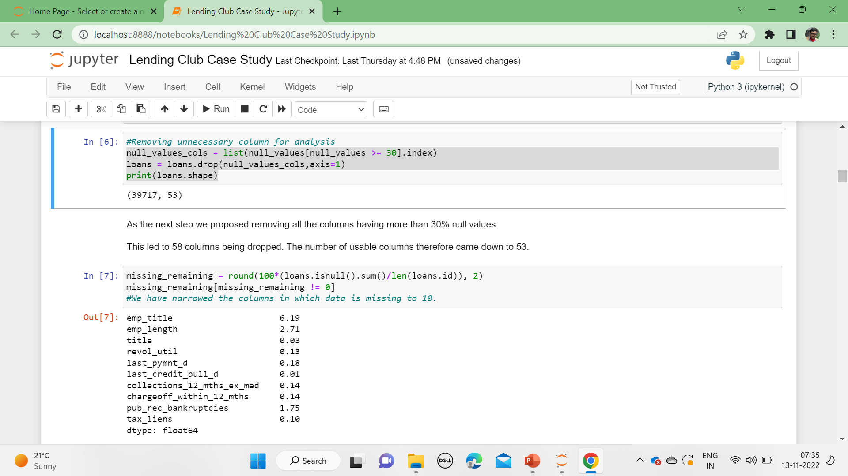
Step B: Data Cleaning
Our first step was to remove the % sign from the “int_rate” column so that the interest rate, a key expected part of the analysis, would appear as a Float.
Our next step was to remove all columns having more than 30% null values. This led to the number of usable columns coming down to 53.
#Converting the interest rate from type string to float
loans['int_rate'] = loans['int_rate'].str.split('%').str[0].astype(float)

Slide 7
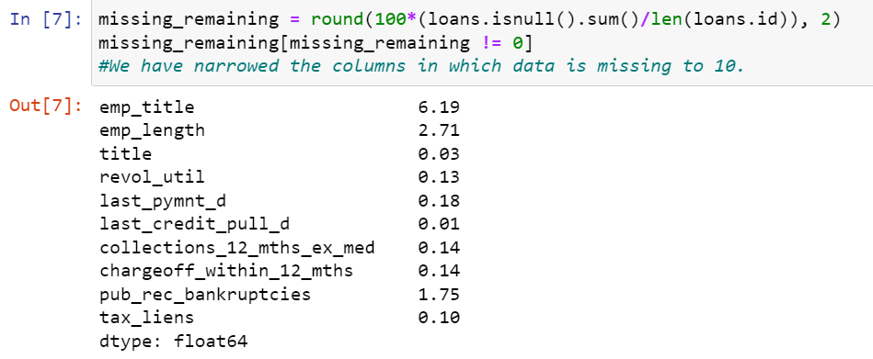
Step B: Data Cleaning…
“emp_title” (Employee title) and ”emp_length” (Employment Length) could be crucial to our analysis. However, these columns had 6.19% and 2.71% null values respectively which might distort our analysis. Hence, we decided to drop the rows where either “emp_title” or “emp_length” was null.
This brought down the number of rows from 39,717 to 37,202.

Slide 8
Step B: Data Cleaning…
“emp_title” (Employee title) and ”emp_length” (Employment Length) could be crucial to our analysis. However, these columns had 6.19% and 2.71% null values respectively which might distort our analysis. Hence, we decided to drop the rows where either “emp_title” or “emp_length” was null.
This brought down the number of rows from 39,717 to 37,202

Slide 9
Step B: Data Cleaning…
The final step was to remove a number of columns that we felt might not add value to our analysis.
That reduced the shape of our data frame to 34 columns.
loans = loans.drop(['delinq_2yrs','earliest_cr_line','inq_last_6mths','open_acc,pub_rec','revol_bal','revol_util','total_acc','out_prncp','out_prncp_inv','total_pymnt','total_pymnt_inv','total_rec_prncp','total_rec_int','total_rec_late_fee','recoveries','collection_recovery_fee','last_pymnt_d','last_pymnt_amnt','last_credit_pull_d','application_type'], axis=1, errors='ignore')
loans.shape

Slide 10
Step b: Data Cleaning…
On further examination, since the values in columns “collections_12_mths_ex_med”, “chargeoff_within_12_mths”, “tax_liens” is 0 or NaN. we decided to drop all such columns without impacting our analysis.
For the variable “Pub_rec_bankruptcies” we propose to replace the null values by the central tendency, that is, Mode. Because in this case, Mode was the clear representation of the variable.
loans = loans.drop(['collections_12_mths_ex_med','chargeoff_within_12_mths','tax_liens'], axis=1)
loans.pub_rec_bankruptcies.fillna(loans.pub_rec_bankruptcies.mode()[0], inplace=True)
print("Pub_rec_bankruptcies:",loans.pub_rec_bankruptcies.unique())
print(loans.pub_rec_bankruptcies.value_counts().to_string(),"\n")
loans.shape

Slide 11
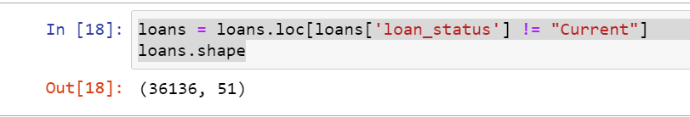
Step b: Data Cleaning…
Aadil: What did we do here?

Slide 12
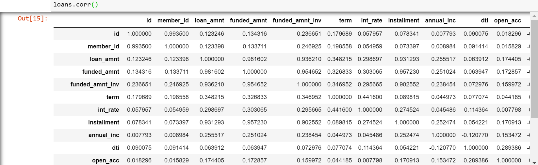
Step C: EXPLORATORY Data ANALYSIS…
Our first step in EDA was to check for the correlation between the different variables.

Slide 13
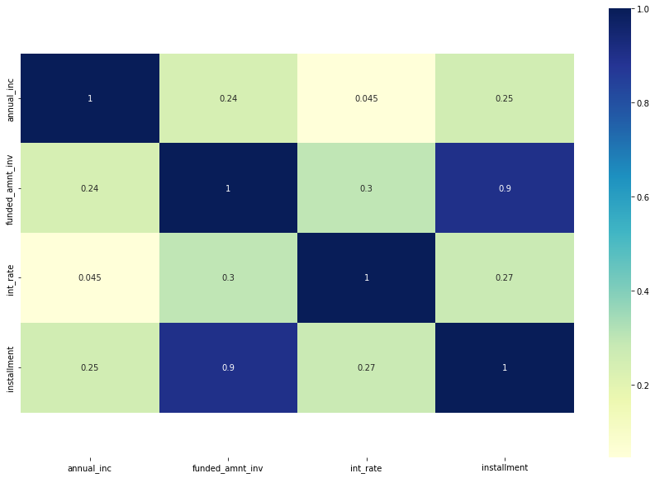
Step C: EXPLORATORY Data ANALYSIS…
Our first step in EDA was to check for the correlation between the different variables.
Nothing major came out here.
There was high correlation between the funded loan and Installment amount… But that was only to be expected.

Slide 14
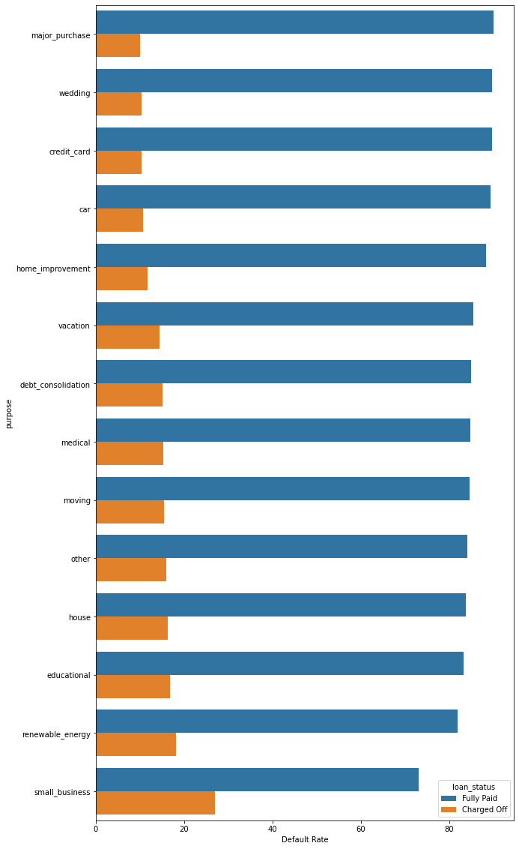
Step C: EXPLORATORY Data ANALYSIS…
Some interesting points came out when we looked at the Reasons for taking the Loan
Investing for Small Business was the reason for the biggest proportion of defaulters by percentage of borrowers.
Those borrowing for Major Purchases, Weddings, Credit Card Payments and Cars formed a comparatively lower proportion of defaulters compared to the other reasons.

Slide 15
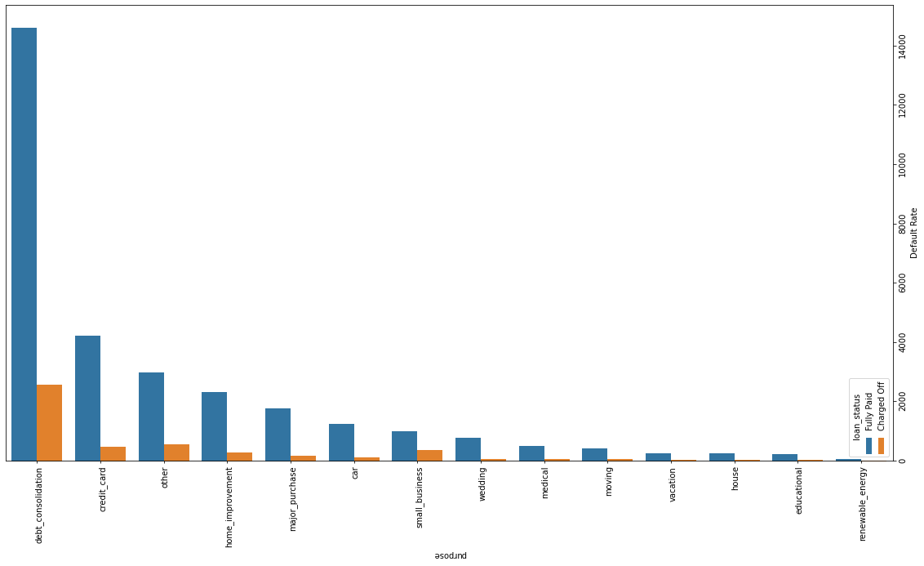
Step C: EXPLORATORY Data ANALYSIS…
But when it came to the total Number of Borrowers, those borrowing for Debt Consolidations, Credit Card Payments and Small businesses constituted a much larger cohort than others.

Slide 16
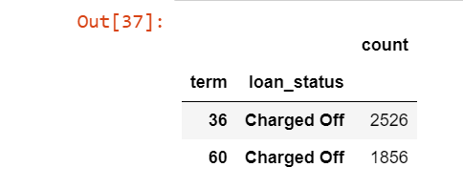
Step C: EXPLORATORY Data ANALYSIS…
Over 60% of the defaulters seems to be from higher tenure of 60 months. Could the Club be better off lending off for shorter tenures?

Slide 17
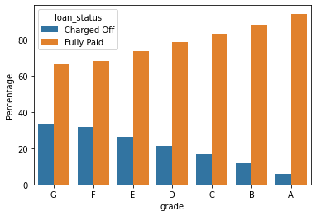
Step C: EXPLORATORY Data ANALYSIS…
It also seemed that the higher the Grade of the borrower(s), the greater was the proportion of defaulters.
The gradation seemed to suggest that the later the alphabet, the greater is the default rate,

Slide 18
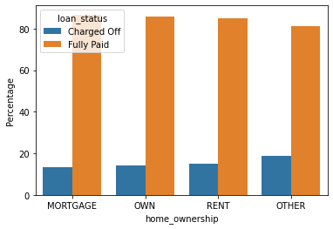
Step C: EXPLORATORY Data ANALYSIS…
When we looked at the Type of Home, those who had not Owned, Mortgaged or Rented their homes, that is those coding “Others” constituted a larger proportion of defaulters.
However, we also saw from the .csv table that “Others” constitute only 18 of the over 5,000 records of Defaulters. Hence, we may consider them aberrations.

Slide 19
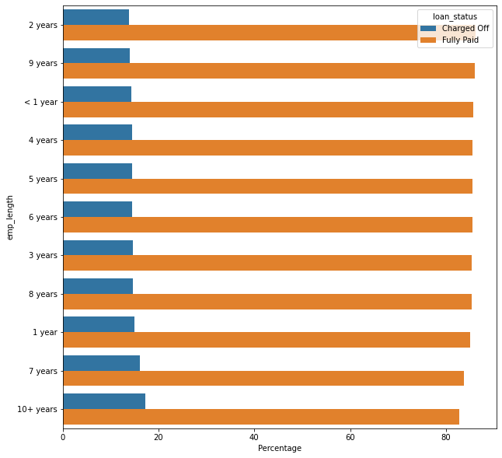
Step C: EXPLORATORY Data ANALYSIS…
Caution ! The proportion of defaulters seems to be highest among those who have been employed for 10 years or more.
While it is obviously attractive to market loans to those who have been employed for long, it would be worthwhile to investigate why those with the highest number of years at their jobs are defaulting the most.

Slide 20
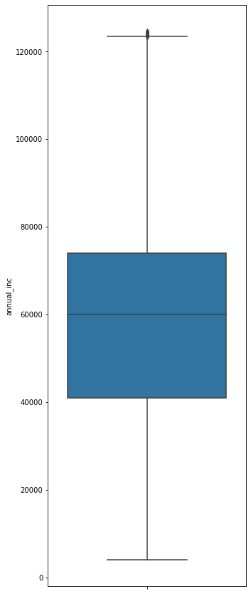
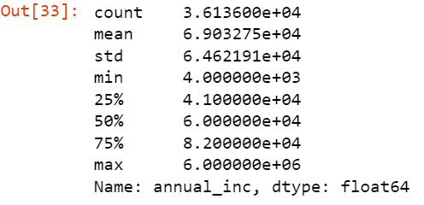
Step C: EXPLORATORY Data ANALYSIS…
The median salary of loan getters stands at 60,000. 75% are under 82,000.There are also outliers.
At the next step we decided to Classify the Income (a float) to three categories, High, Mid Range and Low, for ease of analysis. High = 90,000 and above, Mid Level = Above 40,000 but under 90,000 and Low: Upto 40,000.

Slide 21
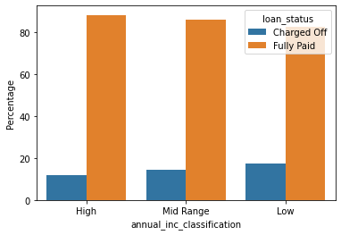
Step C: EXPLORATORY Data ANALYSIS…
It was not surprising that the lower the income, the higher was the default rate.

Slide 22
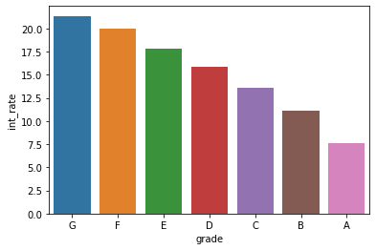
Step C: EXPLORATORY Data ANALYSIS…
Did Interest Rate play a part?
There seems to be a positive correlation between Grade and Interest Rate of Defaulters. Grade then seems to be a Classification of Risk. The higher the risk, the higher the interest levied seems to be a logical conclusion.

Slide 23
Step D: INITIAL OBSERVATIONS, INFERENCES AND IMPLICATIONS
THE “WHAT’S”AND THE “WHO’S” | IMPLICATIONS / HYPOTHESES
Over 60% of the defaulters seems to be from higher tenure of 60 months. | Ought the loan tenure be limited to 3 years / 36 months to increase chances of full repayment?
The higher the Grade of the borrower(s), the greater is the proportion of defaulters as well as the Interest Rate. | The definition of “Grade” would need to be looked into. If Grade = Increased Risk Profile, the numbers make sense.
Those who do not Own, Mortgage or Rent their homes, and code “Others” are a larger proportion of defaulters. However, those coding “Others” are very few in number. | Those coding “Others” are very few and may be disregarded.
The proportion of defaulters seems to be highest among those who have been employed for 10 years or more. | Should the Club be restricting itself to those under 10 years of work experience? May be investigated further.
The lower the income bracket, the higher is the default rate. | Expected. Could something be done to discourage defaults?

Slide 24
Step D: INITIAL OBSERVATIONS, INFERENCES AND IMPLICATIONS
THE “WHY’S” | IMPLICATIONS
Investing for Small Business = reason for the biggest proportion of defaulters by percentage of borrowers. Those borrowing for Major Purchases, Weddings, Credit Card Payments and Cars formed a lower proportion of defaulters compared to the other reasons. | Would need further investigation.
But when it came to the total Number of Borrowers, those borrowing for Debt Consolidations, Credit Card Payments and Small businesses constituted a much larger cohort than others. | Would need further investigation.

Slide 25
ADDITIONAL ANALYSIS: 3 more tables
THE TOTAL OUTSTANDINGS ACROSS THE 3 INCOME GROUPS
THE TOTAL OUTSTANDINGS ACROSS THE 6 PROFILES
Total Outstandings across the following reasons: Debt Consolidations, Credit Card Payments and Small businesses.

Slide 26
Thank you AADIL SHEIKH siddhartha ghosh

